Slide 1
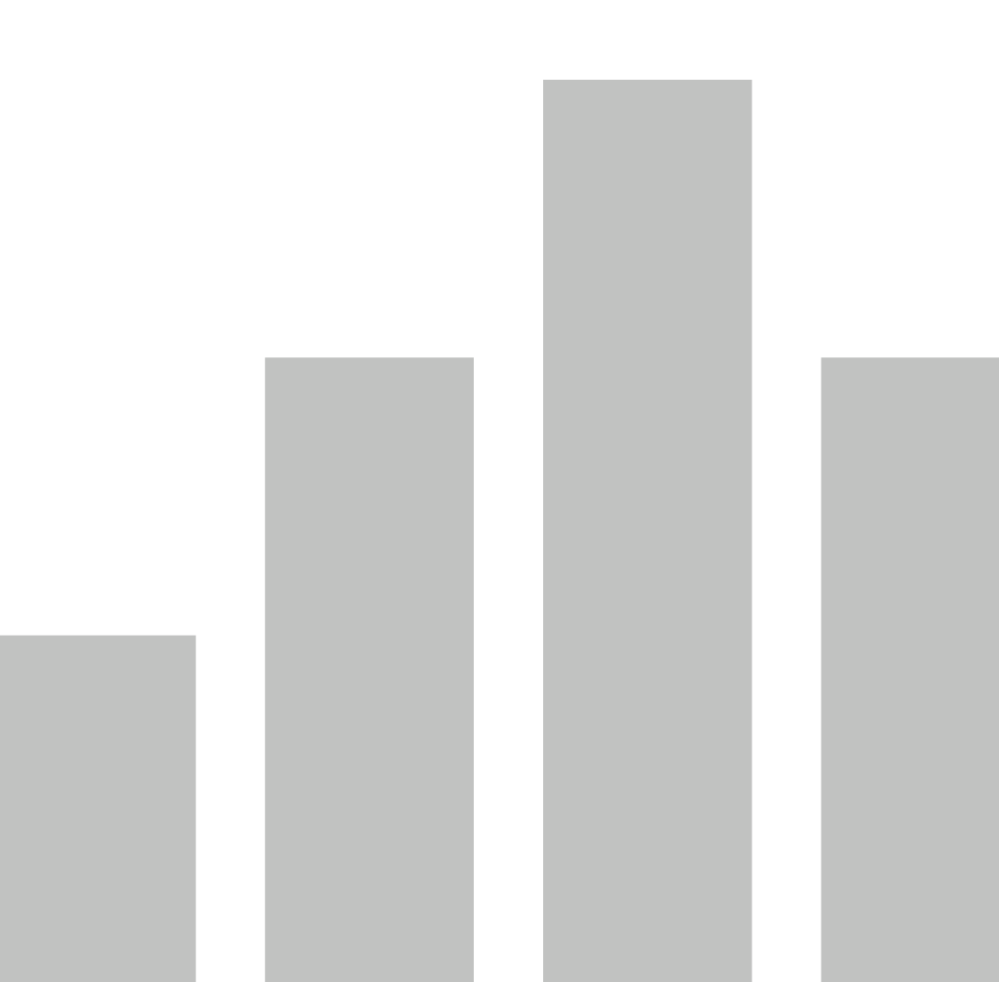


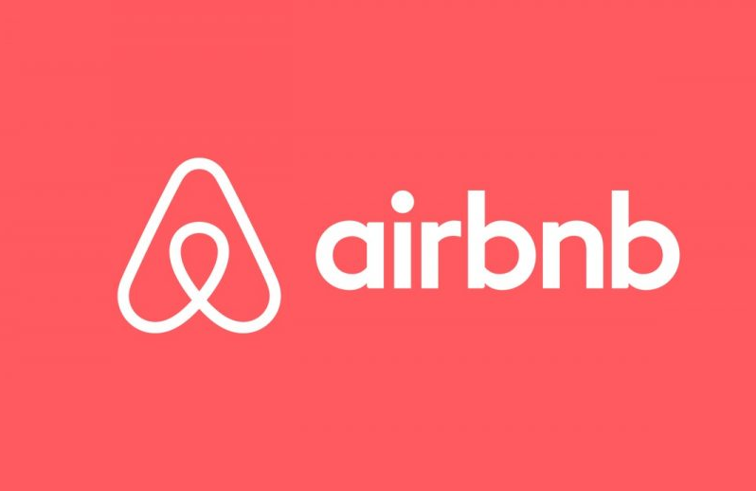
NYC Airbnb 2019
View in Power BI
Last data refresh:
9/30/2020 5:18:51 PM Eastern Standard Time
Downloaded at:
9/30/2020 5:46:34 PM Eastern Standard Time

Slide 2
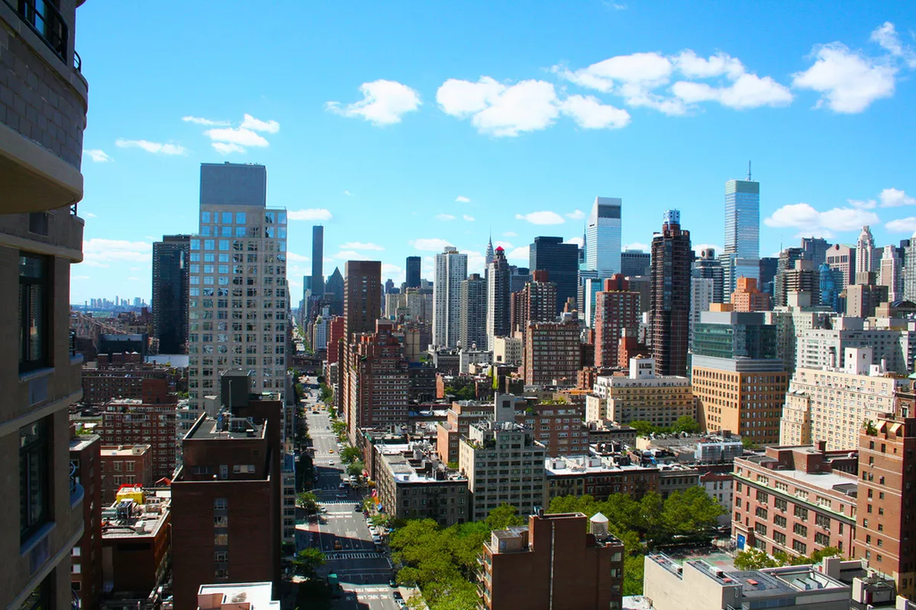
What you should know about Airbnb in NYC
The characteristics of a successful Airbnb in NYC.
Areas of the city that contain the highest Airbnb traffic.
Price predictions for areas across NYC.
This public dataset is part of Airbnb, and the original source can be found on this website.

Slide 3
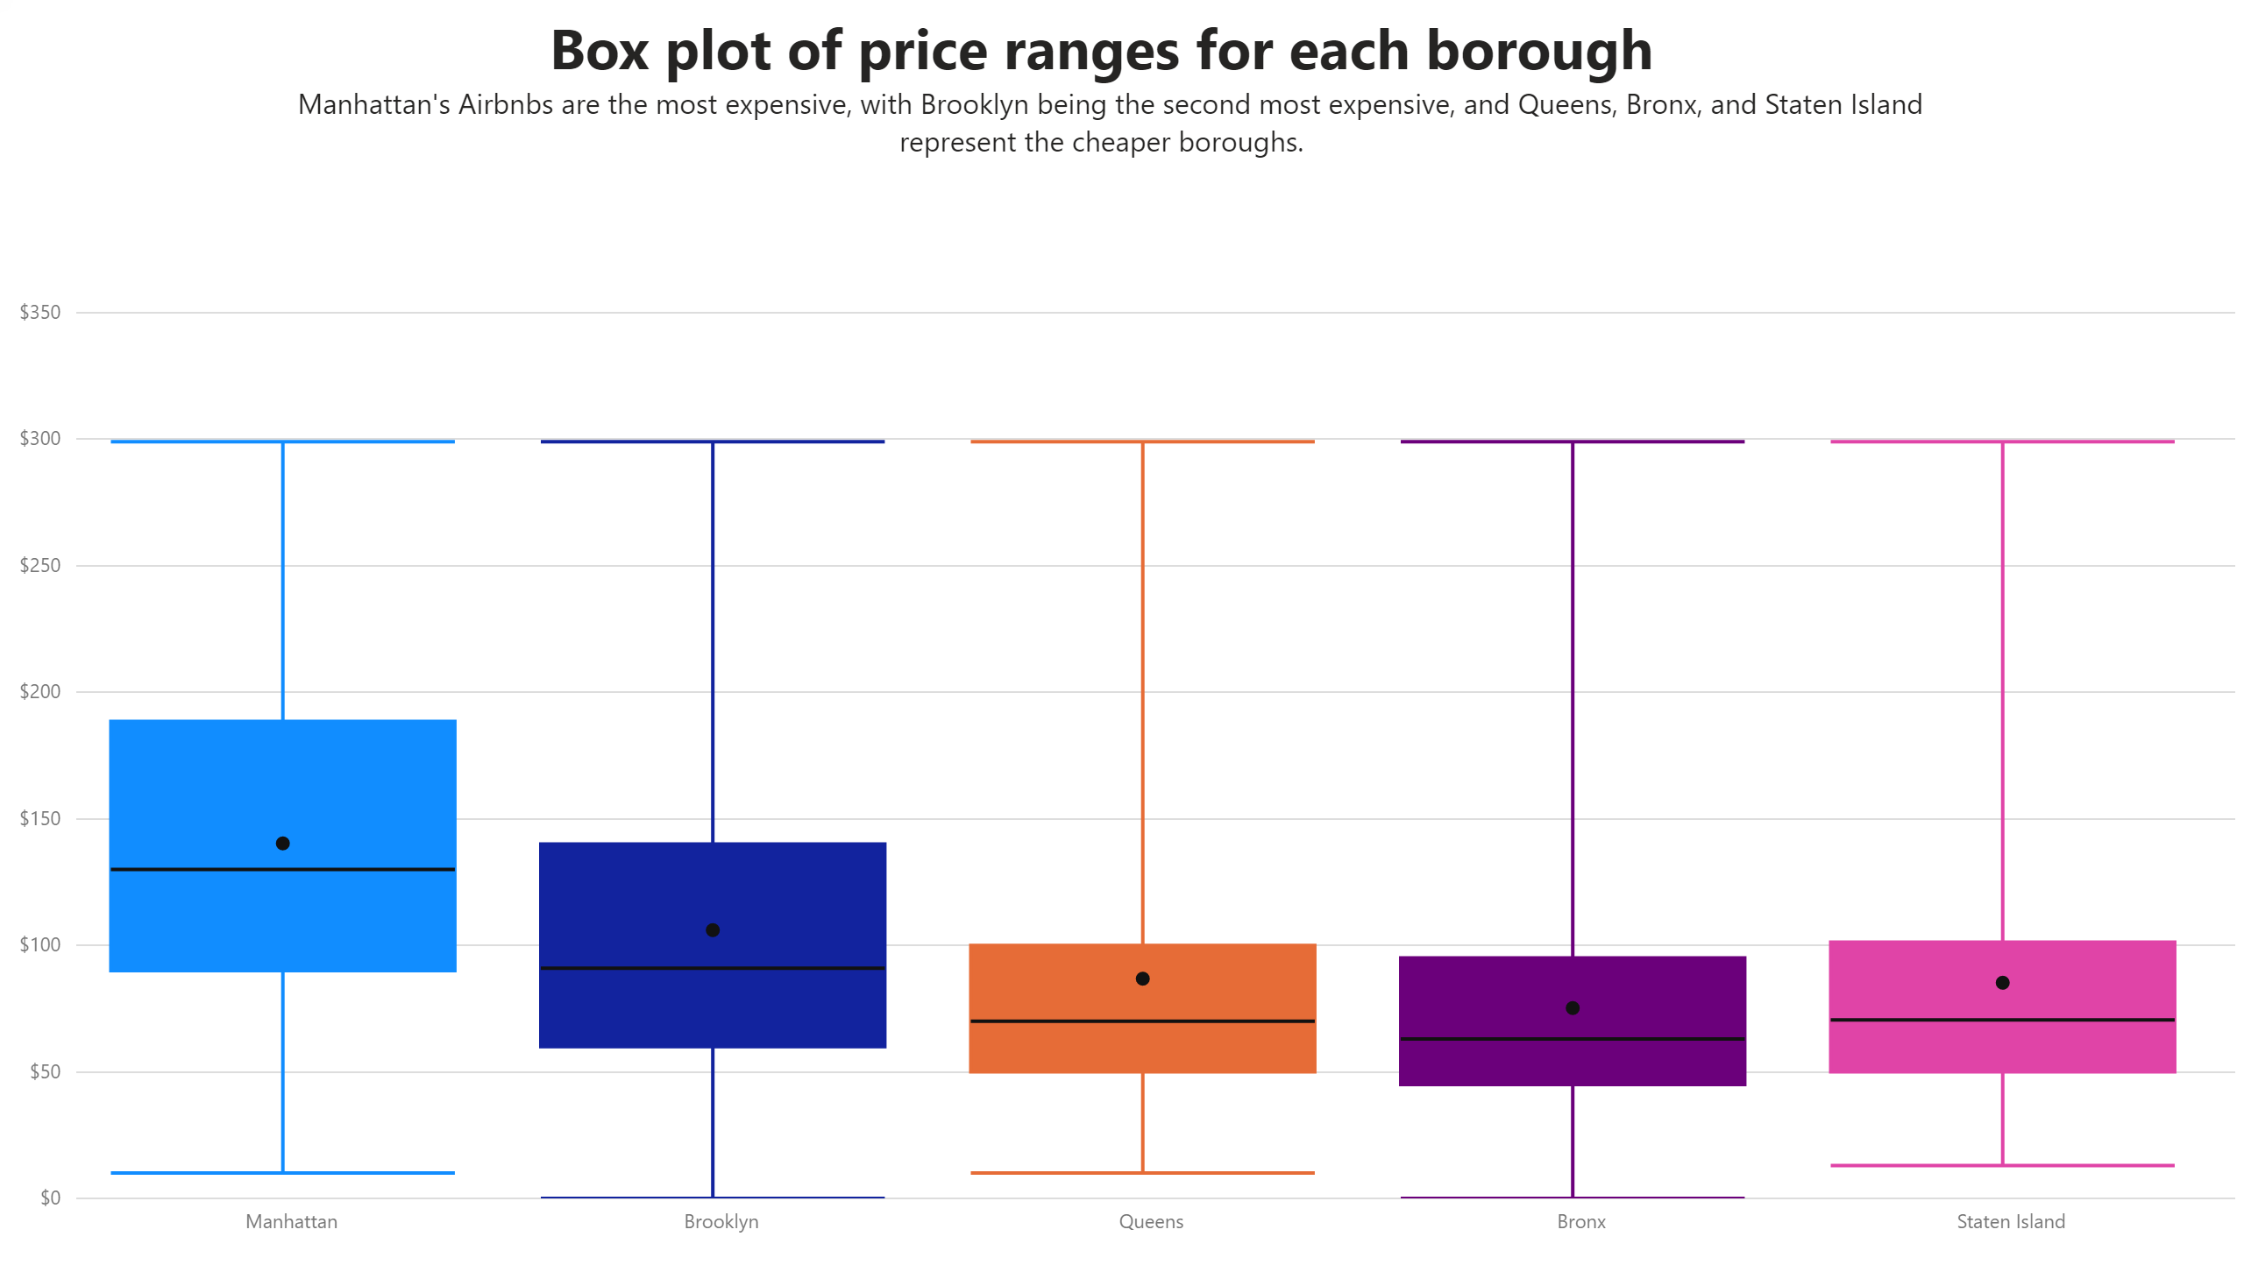
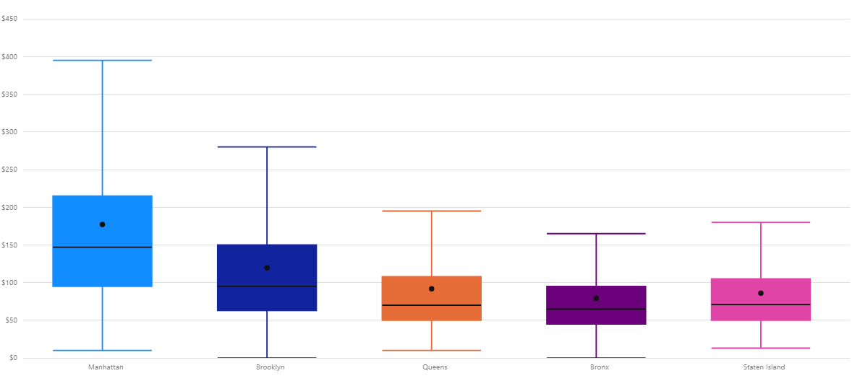
Price range for each borough
Manhattan has the highest prices in the market, brooklyn has the second highest, where Queens, the Bronx, and Staten Island are all much cheaper to rent Airbnbs in.

Slide 4
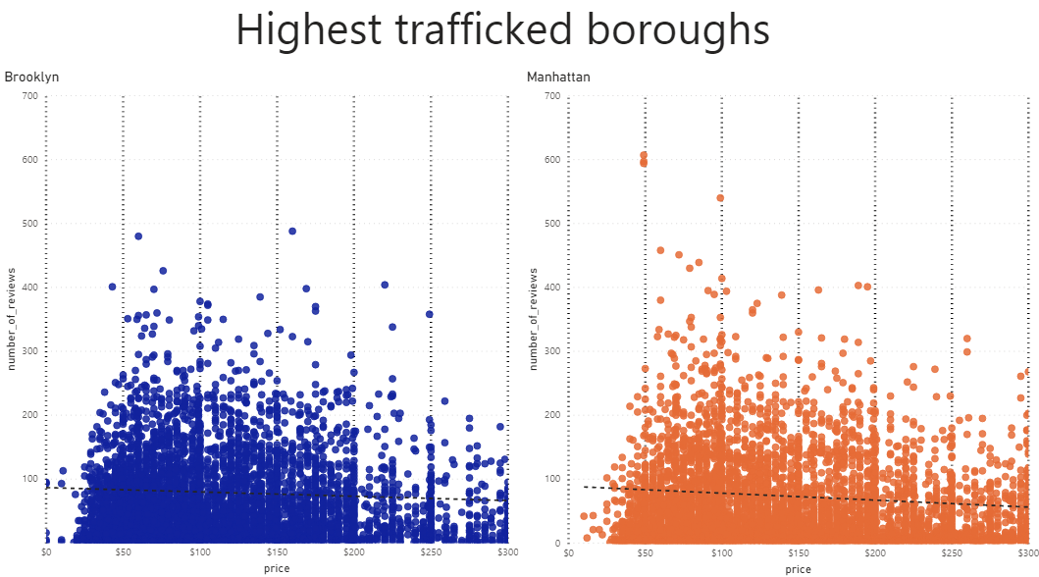
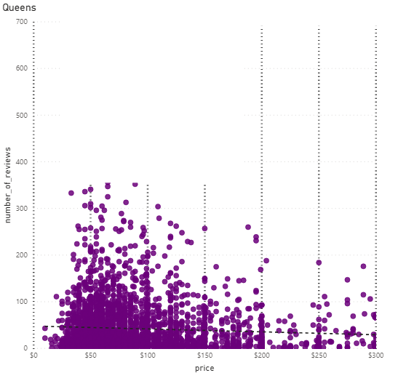
Traffic in borough
Highest trafficked boroughs
Low trafficked borough
High traffic, but less frequent from the 200$ to 300$ price range.
High all around traffic, from 50$ prices to 300$ prices.
Much lower traffic, majority of data in the 25$ - 100$ range.

Slide 5
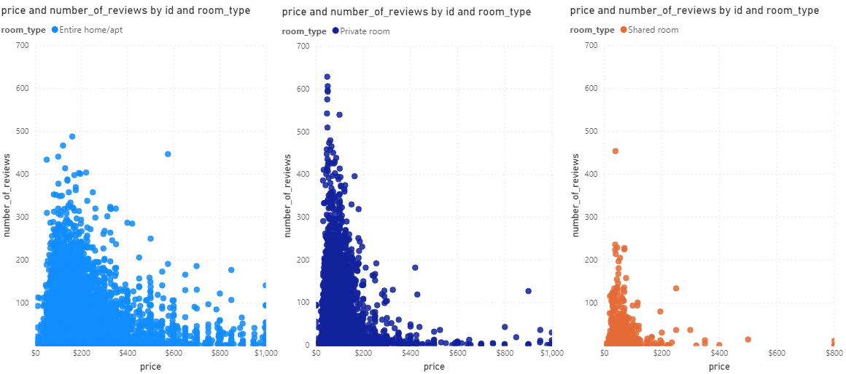
Different types of Airbnb's
Entire home/ Apartment : Higher price range 50 – 500 $ range
Private rooms : Largely makes up 50 – 200 $ range
Much lower traffic, majority of data in the 25 - 100$ range.

Slide 6
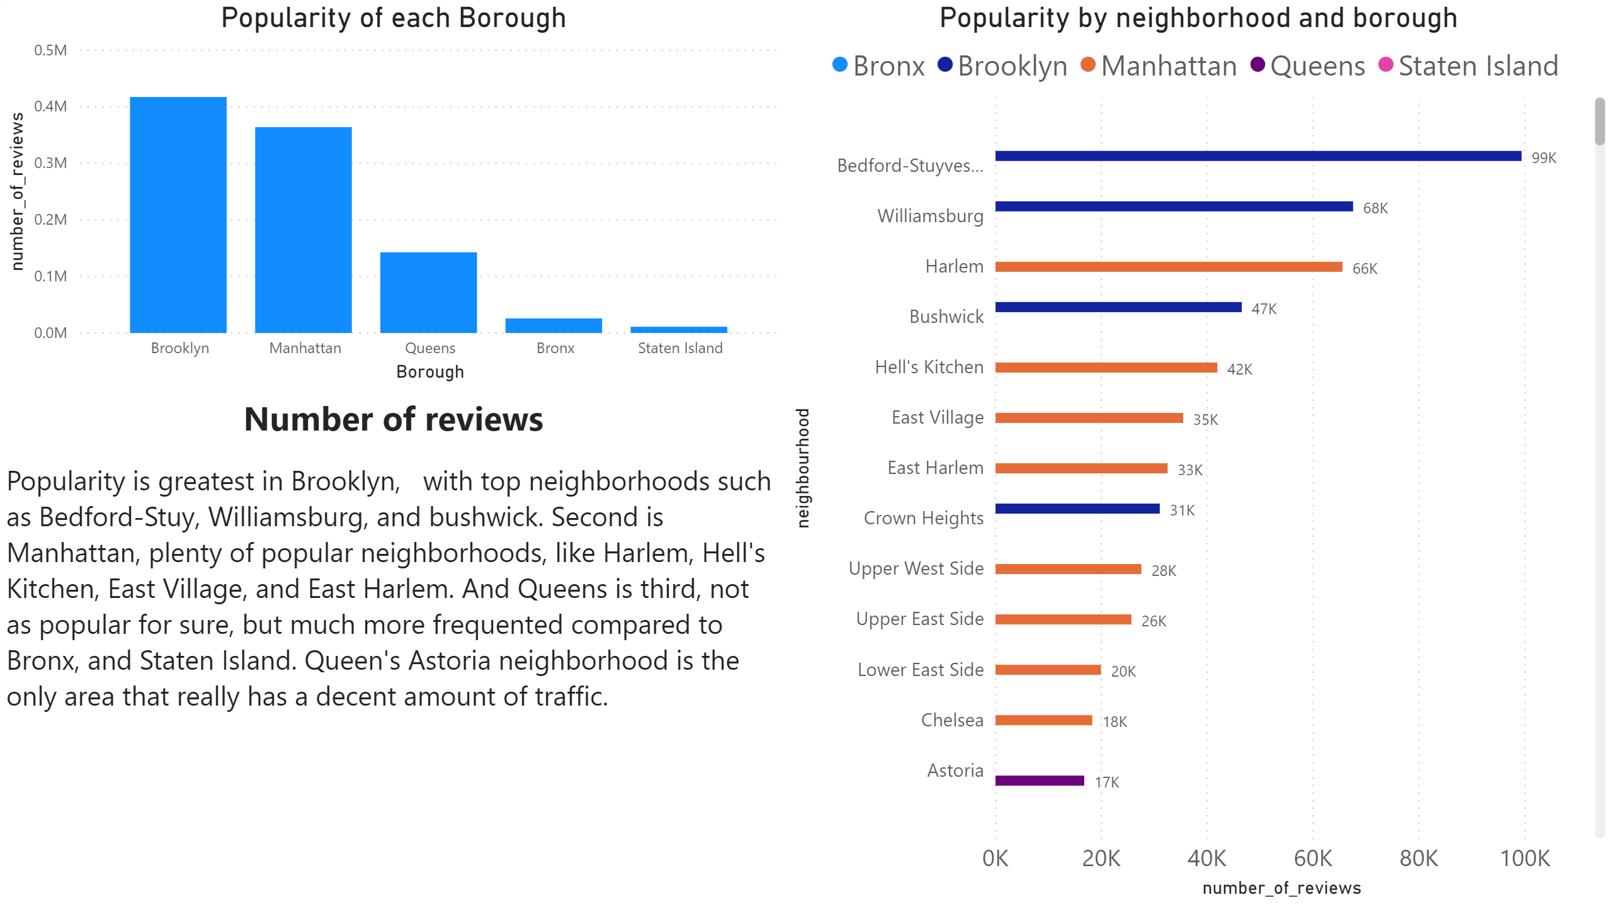

Slide 7
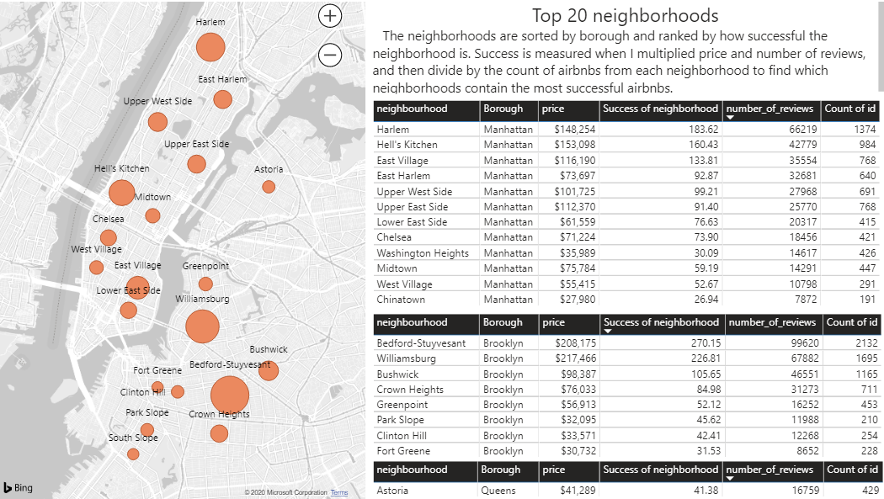
The most successful neighborhoods in NYC
The driving factor of success in tis data is the number of reviews in each neighborhood.
Remember: Price * number of reviews / COUNT of Airbnb's= success of neighborhoods

Slide 8
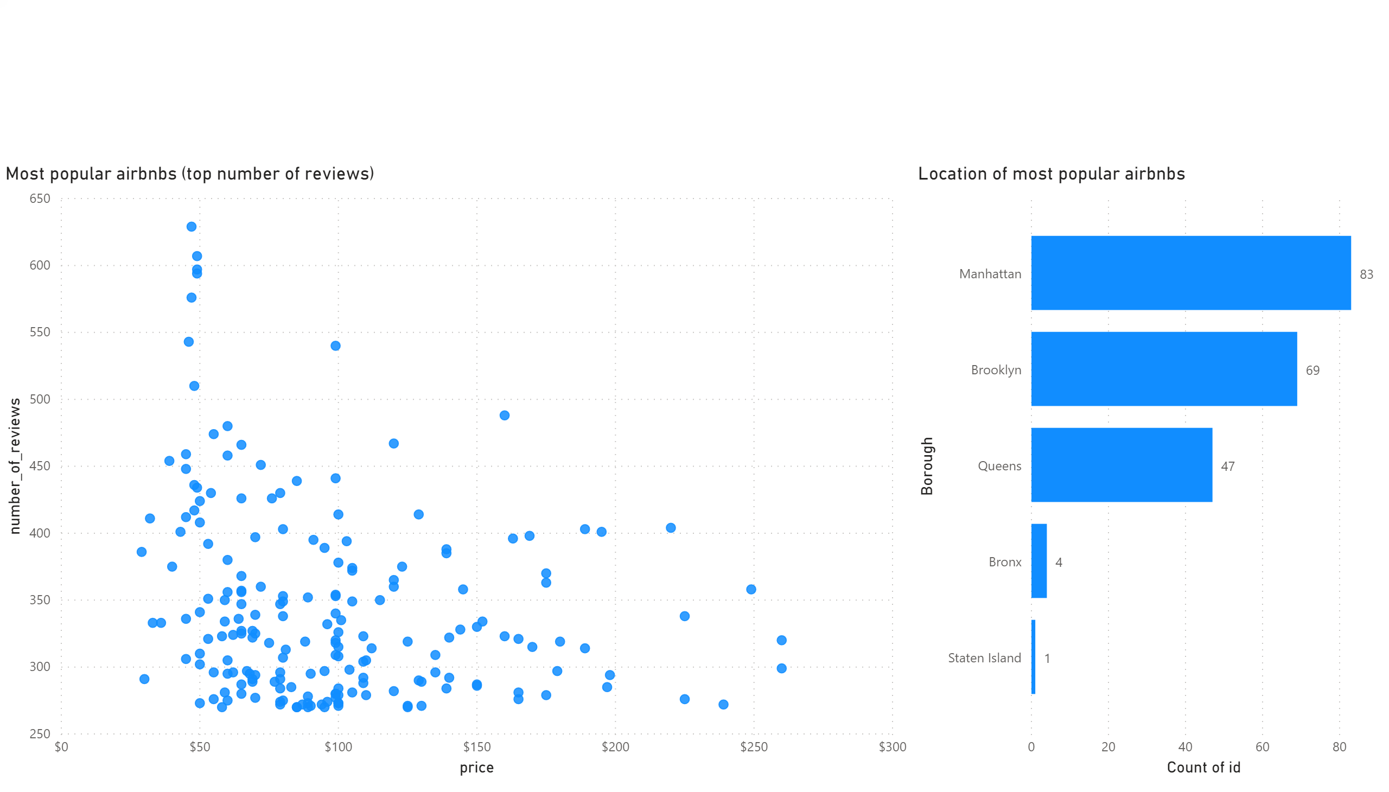
The top 200 most Popular Airbnb’s
We have a range of 260 to 635 reviews for the most popular Airbnb'sin NYC, organized by price range, and borough location.

Slide 9
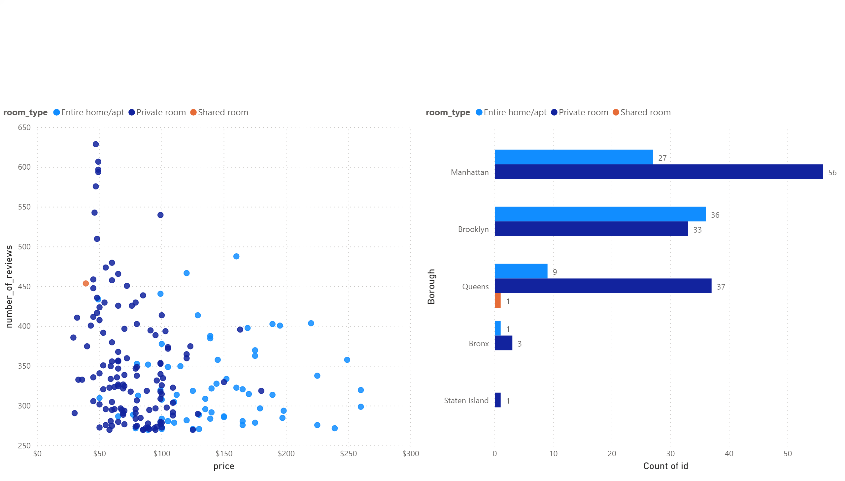
The top 200 most Popular Airbnb’s
The room type of the most popular Airbnb's show that 'Entire Homes/Appartments' take up most of the 100 – 300 dollar range, where 'private rooms' dominate the 50 – 100 dollar range.

Slide 10
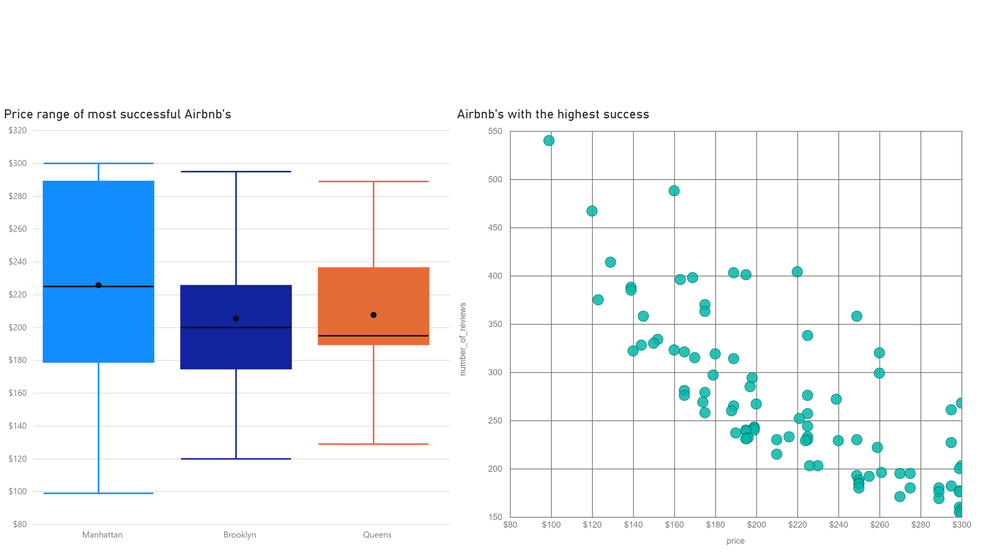
The top 200 most Successful Airbnb’s
I have found that to have a successful Airbnb, they will likely to be located in Manhattan, Brooklyn, or Queens. The most successful Airbnb's in NYC are much more expensive than the regular Airbnb's, but we are certain that the greater the amount of reviews for each Airbnb, the higher you can charge for price of each night.

